Slide 1
MIS FORECASTING DEMAND, AND CONDUCTING MARKET RESEARCH

Slide 2
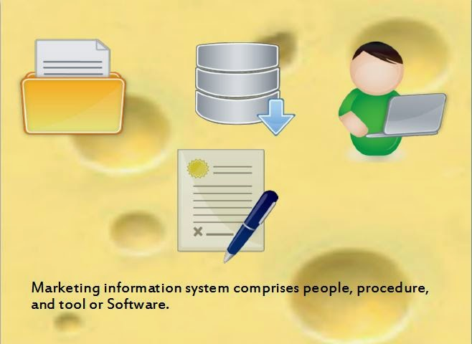
INTRODUCTION TO MARKETING INFORMATION SYSTEM
Marketing information system is a set of objects, elements or components that are interrelated and interact with one another.
The inputs such as physical resources , human resources and information to accomplish common objectives such as productivity and satisfaction,

Slide 3
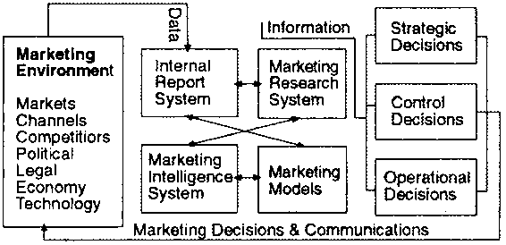
MARKETING INFORMATION SYSTEM(MIS)
The term ‘Marketing Information Systems’ refers to a programmed for managing and organizing information gathered by an organization from various internal and external sources. MIS assesses the information needs of different managers and develops the required information from supplied data in time regarding competition, prices, advertising expenditures, sales, distribution and market intelligence, etc.

Slide 4
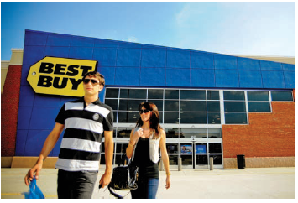
COMPONENTS OF MIS
DATABASE: A database refers to the collection of comprehensive information about customers and prospects such as demographic and psychographic profiles, products and services they buy, and purchase volumes, etc., arranged in a manner that is available for easy access and retrieval.
DATAWAREHOUSING AND DATA MINING:
Data warehousing refers to storing subject-based, integrated, nonvolatile, time variant data in support of managerial decisions. It can be viewed as a central collection of clean, consistent, and summarized information gathered from several operational systems.
The term ‘data mining’ refers to automated data analysis of large amount of data stored in a data warehouse. Data mining creates customer database, which is extremely important for all narrowly defined target-marketing efforts.

Slide 5
INTERNAL RECORDS : Internal database is the most basic starting point in developing a strong MIS. Marketers, not just the growing numbers of large retailers in our country, need information about what is demanded more by customers and what is not. Internal record systems help in tracking what is selling, how fast, in which locations, to which customers, etc. Availability of all such information relies on reports available on orders received from sales people, resellers, and customers, copies of sales invoices, prices, costs, inventories, receivables, payables, etc. Getting inputs and designing systems to provide right data to the right people at the right time is critical for marketing decisions.
EXTERNAL RECORDS: Census Bureau is one key source of information regarding various demographic variables. Besides Census Bureau of India, other sources include Newspapers, Trade Publications , Technical Journals, Magazines, Directories, Balance Sheets of companies, Syndicated and published research reports.
For example, Reader’s Digest markets a database covering 100 million households. It is one of the best databases to assess potential markets for consumer products.

Slide 6
INTERNAL RECORDS
Order-to-Payment Cycle
Sales Information System
Databases, Warehousing, Data mining
Marketing Intelligence System

Slide 7
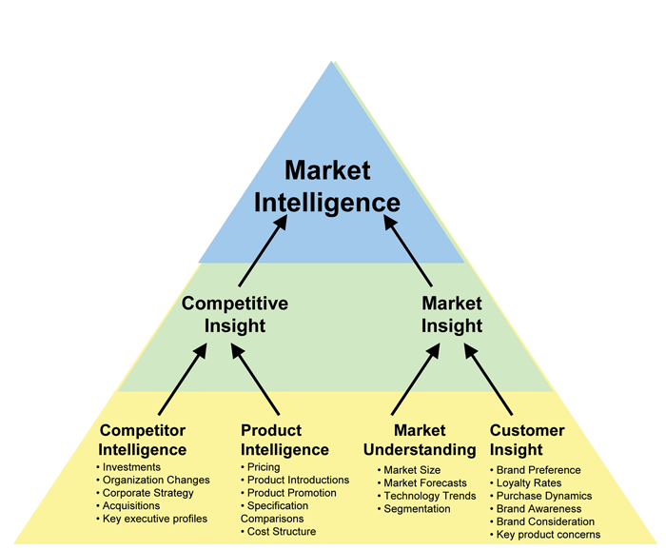
MARKETING INTELLIGENCE
It is a set of procedures and sources that mangers use to obtain everyday information about developments in the marketing environment .Marketing intelligence system refers to systematic and ethical approach, procedures, and sources that marketing managers use to gather and analyze everyday information about various developments with regard to competitors and other business trends in the marketing environment.

Slide 8

STEPS TO IMPROVE MARKET INTELLIGENCE
Train and motivate sales force
Motivate channel members to share intelligence
Hire external experts to collect intelligence
Utilize customer advisory panel
Utilize government data resources
Purchase information from outside suppliers
Collect customer feedback online

Slide 9
SOURCES
Collect market intelligence in a variety of ways
Reading books, newspapers
Talking to customers suppliers and distributors’
Collecting marketing intelligence on the internet
Independent customer goods and review forum
Distributors or sales agent feedback sites
Combo sites offering customer reviews and expert opinions
Customer complaint sites
Public blogs

Slide 10
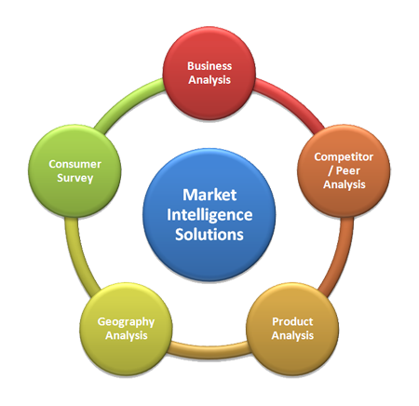
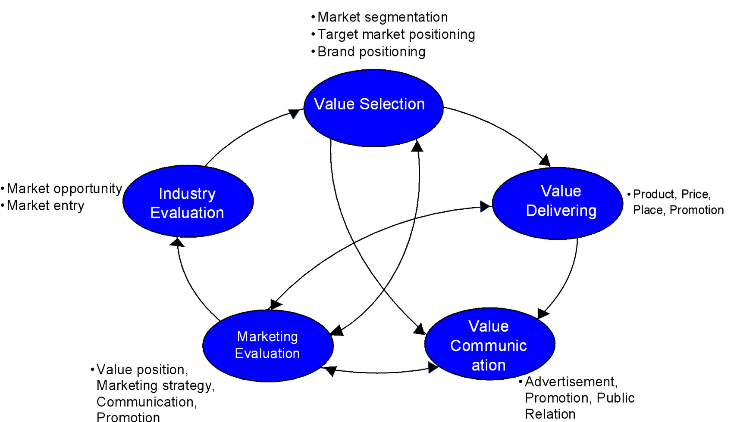
CONT….

Slide 11
Forecasting Methods
Two types of forecasting methods are used to prepare the sales forecast:
Qualitative or Judgmental Methods.
Quantitative Methods.

Slide 12



Qualitative Methods
Qualitative or judgmental methods consider factors related to expertise and human judgment. These methods are generally used in conjunction with some others to build more confidence in the forecast
Jury of Executive Opinion
This forecasting method is quite simple and uses the experience and expertise of senior managers from many functional areas.
Delphi Method
A group of experts expresses their views on different relevant issues such as the expected direction of future business conditions, technology, business activities, new product development, and expected market changes.

Slide 13
Quantitative Methods
The advantage of using quantitative methods of forecasting eliminates any subjectivity that is not possible with qualitative methods.
Simple Projection Method
In its simplest form, adding some fixed percentage of sales growth over the last year’s sales arrives at the sales forecast.
Time Series Analysis
Using this method, the forecaster studies the past sales data of the company and attempts to discover a pattern or patterns in the company’s sales over time.
Time series approach generally involves trend analysis, cycle analysis, seasonal analysis, and random factor analysis.
Market Tests
This method involves making the product available to potential customers in one or more test markets to measure their response to price, promotion, and distribution.

Slide 14



FORECASTING AND DEMAND MEASUREMENT

Slide 15
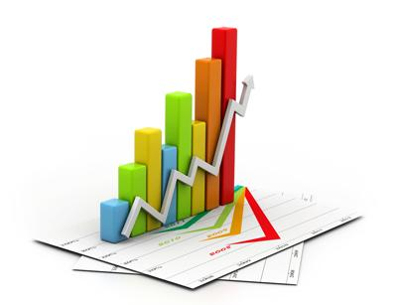
INTRODUCTION
“Ignoring demand is the major weakness in marketing”.
Demand refers to willingness and desire to buy and ability to pay.
Understanding the marketing environment and conducting marketing research can help to identify marketing opportunities.
Sales forecasts prepared by marketing are used by finance to raise cash for investment and operations, by manufacturing to establish capacity and output . The important point it tries to bring out
1. To acquire right amount supplies
2. To hire needed workers

Slide 16

MARKET DEMAND
The total market demand for a product or service is the total volume that would be bought by a deﬁned consumer group in a deﬁned geographic area in a deﬁned time period in a deﬁned marketing environment under a deﬁned level and mix of industry marketing effort.
Marketers will want to estimate three aspects of current market demand—total market demand, area market demand, and actual sales and market shares

Slide 17


CONT….
There are many productive ways to break down the market
Potential market
Available market
Target market
Penetrated market

Slide 18


CONT……
Available market:- the set of consumers who have interest ,income and access to a particular offer
Target market:- it is a part of the qualified available market the company decides to pursue.
Penetrated market:- it is the set of consumers who are buying the company’s product.
Potential market:-the set of consumers with a sufficient interest in a market offer. However their interest is not enough to define a market unless they also have sufficient income and access to the product

Slide 19
Basic concepts
MARKET DEMAND: Market demand for a product is the total volume that would be bought by a defined customer group in a defined geographical area in a defined time period in a defined marketing environment under a defined marketing program
MARKET FORECAST: Only one level of industry marketing expenditure will actually occur. The market demand corresponding to this level is called the market forecast.
MARKET POTENTIAL: The market forecast shows expected market demand, not maximum market demand. Market potential is the limit approached by marketing expenditures approach infinity for a given marketing environment.

Slide 20
COMPANY DEMAND: It is the company’s estimated share of market demand at alternative levels of company marketing efforts in a given time period.
COMPANY SALES FORECAST: The company sales forecast is the expected level of company sales based on a chosen marketing plan and an assumed marketing environment.
COMPANY SALES POTENTIAL: It is the sales limit approached by company demand as company marketing effort increases relative to that of competitors.

Slide 21
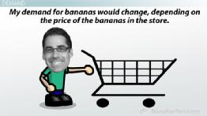
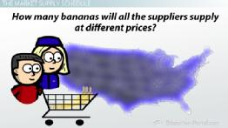
ASPECTS OF ESTIMATING THE CURRENT DEMAND
Area market demand
Actual sales
Market shares

Slide 22

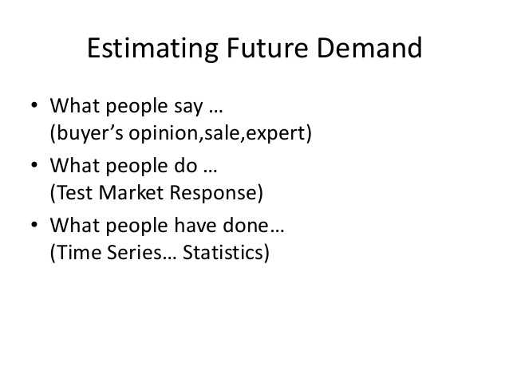
ASPECTS OF ESTIMATING FUTURE DEMAND
Survey of buyers’ intentions:-buyer’s behaviour is most important. Buyer’s should be surveyed for major consumer durables.
Example : appliances
Composite of sales force opinions
Expert opinion:-forecasts from experts including dealer,distributors,suppliers,marketing consultants, and trade association

Slide 23
CONT….
Past-sales analysis:-sales forecasts can be developed on the basis of past sales. Time series analysis is useful tool in past time series into three components
Trend cycle
Seasonal
Erratic
Market test method:- When buyer’s do not plan their purchases carefully or experts are not available. A direct market test is especially desirable in forecasting new product sales or established product sales in a new sales distribution

Slide 24
Measuring Current Demand
Marketers will want to estimate three aspects of current market demand—
Total market demand:- The total market demand for a product or service is the total volume that would be bought by a defined consumer group in a defined geographic area in a defined time period in a defined marketing environment under a defined level and mix of industry marketing effort.
Total market potential=potential number of buyers*average quantity purchased by a buyer*the price .
i.e. Q = n*q*p
For example, next year’s total market demand for ice cream in Canada will depend on how much the makers of Sealtest, Haagen-Dazs, Parlour, President’s Choice, and other brands spend on marketing.

Slide 25
2. Area market demand:- Companies face the problem of selecting the best sales territories and allocating their marketing budget optimally among these territories. Therefore, they need to estimate the market potential of different cities, provinces, and countries. Two major methods are available:
Market-Buildup Method : The market-buildup method calls for identifying all the potential buyers in each market and estimating their potential purchases.
Market-Factor Index Method : Consumer goods companies also have to estimate area market potentials. A common method for calculating area market potential is the market-factor index method, which identifies market factors that correlate with market potential and combines them into a weighted index.
MRI = percentage of national retail sales in the area/ percentage of national
population in the area.

Slide 26
3. Actual sales and market shares:- Besides estimating total and area demand, a company will want to know the actual industry sales in its market. Thus, it must identify its competitors and estimate their sales.
For example, A.C. Nielsen, IRI, and other marketing research firms use scanner data to audit the retail sales of various product categories in supermarkets and drugstores, and they sell this information to interested companies.

Slide 27
Estimating Future Demand
Forecasting is the art of estimating future demand by anticipating what buyers are likely to do under a given set of future conditions. Poor forecasting can lead to overly large inventories, costly price markdowns, or lost sales due to items being out of stock.
Companies commonly use a three-stage procedure to arrive at a sales forecast.

Slide 28
First they make an environmental forecast :- The environmental forecast calls for projecting inflation, unemployment, interest rates, consumer spending and saving, business investment, government expenditures, net exports, and other environmental events important to the company.,
Second an industry forecast :- The result of the environmental forecast is a forecast of gross domestic product, which is used along with other indicators to forecast industry sales.,
Thirdly a company sales forecast :- Then the company prepares its sales forecast by assuming that it will win a certain share of industry sales.

Slide 29
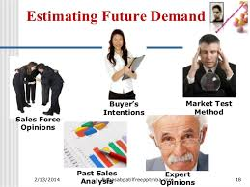
Companies use several specific techniques to forecast their sales. All forecasts are built on one of three information bases:
BASED ON | METHODS
1. What people say | Surveys of buyers’ intentions Composite sales force opinions Expert opinion
2. What people do | Test markets
3. What people have done | Time-series analysis Leading indicators Statistical demand analysis

Slide 30
SURVEY OF BUYERS’ INTENTIONS:- One way to forecast what buyers will do is to ask them directly. This suggests that the forecaster should survey buyers. Surveys are especially valuable if the buyers have clearly formed intentions, will carry them out, and can describe them to interviewers.
COMPOSITE OF SALES-FORCE OPINIONS:- When buyer interviewing is impractical, the company may base its sales forecasts on information provided by the sales force. The company typically asks its salespeople to estimate sales by product for their individual territories. It then adds up the individual estimates to arrive at an overall sales forecast.
EXPERT OPINION:- Companies can also obtain forecasts by turning to experts. Experts include dealers, distributors, suppliers, marketing consultants, and trade associations. Thus, auto companies survey their dealers periodically for their forecasts of short-term demand.

Slide 31
TEST MARKETING:- Where buyers do not plan their purchases carefully or where experts are not available or reliable, the company may want to conduct a direct test market. A direct test market is especially useful in forecasting new-product sales or established product sales in a new distribution channel or territory.
PAST-SALES ANALYSIS:- Sales forecasts can be developed on the basis of past sales. Time-series analysis consists of breaking down past time series into four components (trend, cycle, seasonal, and erratic) and projecting these components into the future.
LEADING INDICATORS :- Many companies try to forecast their sales by finding one or more leading indicators— other time series that change in the same direction but in advance of company sales. For example, a plumbing supply company might find that its sales lag behind the housing starts index by about four months. The housing starts index would then be a useful leading indicator.

Slide 32

Marketing Research System
Marketing managers often commission formal marketing studies of specific problems and opportunities.
They may request a marketing survey
It’s based on region or an advertising evolution
It’s the job of marketing researchers to provide the insight into the customer’s attitudes and buying behavior
Marketing insight provide diagnostic information about how and why certain effects in the marketplace and what that mean to marketers
Good marketing insights often from the basis of successful marketing program

Slide 33
MARKETING RESERCH PROCESS
DEFINE THE PROBLEM AND RESERCH
OBJECTIVE
DEVELOP
THE
RESERCH
PLAN
COLLECT
THE
INFORMATION
ANALYZE
THE
INFORMATION
PRESENT
THE
FINDINGS
MAKE
THE
DECISION

Slide 34

Step1:DEFINE THE PROBLEM AND RESERCH OBJECTIVE
Problem should not be defined either too broadly or too narrowly
Very broad definitions leads to excessive wastage of recourses
Too narrow information leads to inadequate data
Two are important
What to be researched (the content, the scope)?
Why to be researched (the decisions that are to be made)?
Purpose of research must be meaningful that will help in taking effective decisions
In the end the problem must be clearly defined

Slide 35

Step2:DEVELOP THE RESEARCH PLAN
This involve decision on source, research approaches, research instruments sampling plan.
DATA SOURCE
The research can gather secondary data or primary data or both
Secondary data is nothing but the data collected for another purpose
Primary data is the data collected only for the specific purpose
Usually researchers start their investigation by examining secondary data to see whether the problem can be solved without collecting the costly primary data.

Slide 36
VARIOUS APPROACHES OF RESEARCH
FOCUS GROUP RESEARCH
ETHNOGRAPHIC RESEARCH
SURVEY RESEARCH
BEHAVIORAL DATA
EXPERIMENTAL RESEARCH
RESEARCH INSTRUMENTS
QUESTIONNAIRE

Slide 37
CONT…
Observation: Researchers can do the research by observing the as they shop or as they consume products some times they may give the customers to write there opinion and take some interviews.
Ethnographic research refers to particular observational research approach that uses concepts and tools from anthropology and other social science disciplines to provide deep understanding of hoe people live and work.
Focus group research is a gathering of six to ten people who are invited to spend a few hours with a skilled moderator in order to discuss a product, service, organization or any other entity. There will be offered with some attractive gifts for their participation
Survey research is best suited for descriptive research. Companies undertake surveys to learn about people ‘s knowledge ,beliefs ,preferences and satisfaction.
Behavioral data is an approach in which customers actual purchases reflect the preferences and are normally more reliable than memory -based statements made in surveys

Slide 38
CONT….
Experimental research refers to thee most scientifically valid research of which the purpose is to capture cause and effect relationships by eliminating competing explanations of the observed findings.
Research instruments :- marketing researchers have a three main research instruments :-
Questionnaires
Qualitative measures
Technological devices

Slide 39

Collecting data is one of the most expensive and the most prone to error. Marketers collect the data from the different sources like internet, survey, phone, interviews. Difficulties come in this are some will respond some may not some may be honest some may not. Coming to the internationally different people are in different behavior some may not be comfortable with internet survey they want to end up with personal survey.
Step3:COLLECT THE INFORMATION

Slide 40

Step4:Analyzing the Information Analyzing the collected data and tabulating the data and devolving summary measures Making various statistical techniques and decision models in the hope of discovering additional findings Step5: Present the findings At the last step researchers present findings relevant to the major marketing decisions facing management Step6: Make the Decision Researchers only provide additional information and insight to mangers Depending on their findings mangers decide to use it. Discard it or carry out more research.

Slide 41
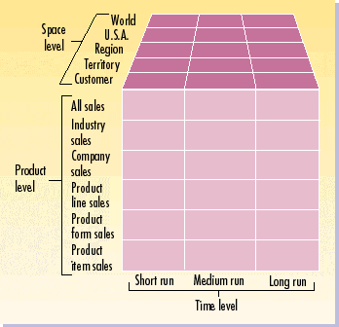
CONT…..

Slide 42
MARKETING DASHBOARDS
Meaning:
It is a organizational processes and systems to make sure they maximize the value of all these different metrics. In management it can assemble a summary set of relevant internal and external measures in a “marketing dashboard” for synthesis and interpretation.
They are only as good as the information on which they’re based, but sophisticated visualization tools are helping bring data alive to improve understanding analysis

Slide 43
THANK YOU

